Slide 1
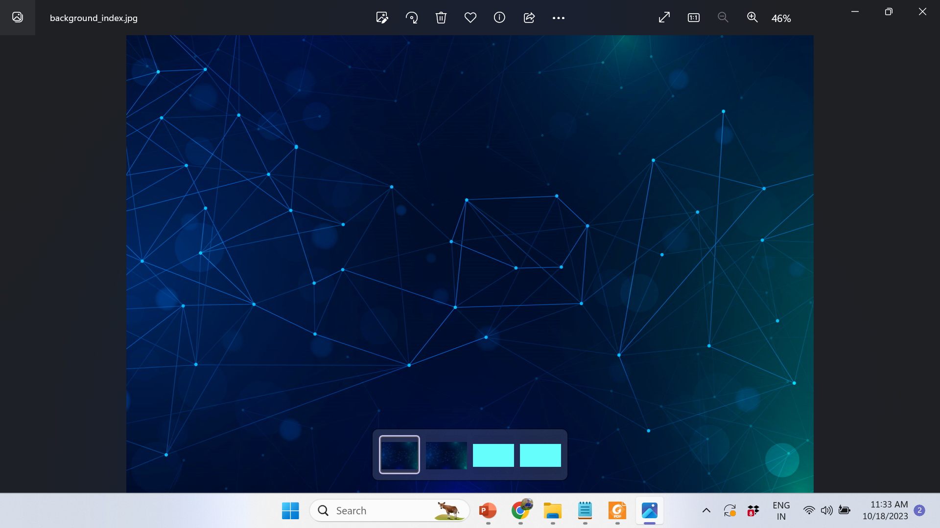
Network Intrusion Detection System
By:
U.Rohith(9920004138)
P.Lakshmi Chaitanya(9920004261)
U.Anil Kumar(9920004263)
K Paramesh(9920004808)

Slide 2
Abstract
Network intrusion detection technology plays an important role in maintaining network security, the main work is to continuously detect the current network status, through the detection of abnormal behavior in the network state, timely warning to alert network managers.
The timeliness and accuracy of the intrusion detection system (IDS) is critical to the availability and reliability of the current network. In response to the problems of high false alarm rate, low detection efficiency and limited functions commonly found in IDS.
With the growing reliance on networked systems and the increasing sophistication of cyber threats, the need for robust network intrusion detection systems (NIDS) has become paramount.
We are going to implement a Network Intrusion Detection System that leverages both traditional machine learning and deep learning algorithms to enhance network security.collecting and preprocessing network traffic data, which serves as the foundation for training and testing the intrusion detection models.

Slide 3
Objective
The objective of a project on a Network Intrusion Detection System (NIDS) using machine learning and deep learning algorithms is to develop a system that can effectively detect the attack type
Use machine learning and deep learning algorithms to identify abnormal patterns and behaviors in network traffic.Identification of Intrusions: Detect and classify different types of network intrusions, such as malware attacks, 'apache2', 'back', 'buffer_overflow', 'ftp_write’ and other malicious attacks.
We are going to implement the machine learning algorithms such as DecisionTreeClassifier,KNeighborsClassifier,LogisticRegression,MultinomialNB,RandomForestClassifier,SupportVectorMachines and deeplearing algorithms such as CNN,FNN,RNN to predict the attack type and compare their accuracies
the final attack type is considered from the algorithm which gives the highest accuracy

Slide 4
Literature Survey
Year | Author(s) | Title | Methodology | Key Findings and Contributions
2016 | K. Revathi, Dr. M. Ramakrishnan | A Survey of Network Intrusion Detection Techniques | Survey of Network Intrusion Detection Techniques | Provides an overview of various network intrusion detection techniques and their strengths and weaknesses.
2019 | S. Ma, L. He, J. Ding, and X. Wang | Anomaly-Based Intrusion Detection System Using Autoencoders | Autoencoders for Anomaly Detection | Demonstrates the effectiveness of autoencoders for identifying network anomalies in intrusion detection.
2021 | R. K. Gupta, A. K. Bhattacharjee, and A. K. Mehta | Deep Learning for Network Intrusion Detection: A Review | Deep Learning Techniques (CNN, LSTM, etc.) | Provides a comprehensive review of deep learning methods for network intrusion detection, emphasizing their potential in handling complex attacks.

Slide 5
Year | Author(s) | Title | Methodology | Key Findings and Contributions
2016 | A. Ahmed, R. Hu, H. Hu, and Y. Y. Hu | Evaluating the Performance of Machine Learning Algorithms in Network Intrusion Detection | Comparative Study of Machine Learning Algorithms | Compares the accuracy and computational overhead of different machine learning techniques for network intrusion detection.
2016 | Kim, Y., Lee, K., & Kim, J. | Intrusion Detection System using LSTM Networks | Long Short-Term Memory (LSTM) Networks | Demonstrates the benefits of using LSTM networks for capturing temporal patterns in network traffic.
2018 | A. Islam, M. Zulkernine | A Deep Learning Approach to Network Intrusion Detection | Stacked Autoencoders and Convolutional Neural Networks (CNN) | Shows how CNNs can be used for feature extraction and classification in network intrusion detection.

Slide 6
Year | Author(s) | Title | Methodology | Key Findings and Contributions
2018 | A. Islam, M. Zulkernine | A Deep Learning Approach to Network Intrusion Detection | Stacked Autoencoders and Convolutional Neural Networks (CNN) | Shows how CNNs can be used for feature extraction and classification in network intrusion detection.
2019 | S. M. Sharifipour and S. M. A. Samad | A Survey of Network Intrusion Detection Systems | Survey of Network Intrusion Detection Systems | Provides an overview of various network intrusion detection systems and their evolution, emphasizing the shift towards machine learning and deep learning methods.

Slide 7
Existing Systems
Several existing systems serve as robust models for Network Intrusion Detection Systems (NIDS), each with its unique approach to detecting and mitigating network threats. One prominent system is Snort, an open-source NIDS renowned for its versatility and wide community support. Snort operates through signature-based detection, employing a rule-driven mechanism to identify known patterns of malicious activities within network traffic. Its modular design allows for flexibility in rule creation and modification, catering to diverse network architectures and threat landscapes.
Another significant system is Suricata, a high-performance NIDS recognized for its multi-threaded architecture and robustness in handling high-speed network traffic. Similar to Snort, Suricata utilizes signature-based detection but also incorporates emerging technologies such as protocol anomaly detection and support for threat intelligence feeds.
Furthermore, Bro (now known as Zeek) stands out as a powerful NIDS offering a unique approach through its network traffic analysis framework. Bro focuses on protocol analysis, providing in-depth visibility into network communications by generating high-level logs that can be utilized for both real-time monitoring and post-incident analysis.

Slide 8
Problem Statement
The primary problem statement involves the creation of an intelligent and adaptable NIDS capable of autonomously detecting and classifying various types of network intrusions, including novel and previously unseen threats. By harnessing the capabilities of advanced algorithms, this project seeks to enhance the accuracy and efficiency of intrusion detection while minimizing false positives
key challenges:
High-Dimensional Data: Network traffic data can be complex and high-dimensional, making it challenging to extract meaningful features for intrusion detection.
Multi-Class Classification: The NIDS should classify network traffic into various categories, such as normal, intrusion, and specific attack types.
False Positive Reduction: Minimizing false positives is crucial to avoid overwhelming security teams with irrelevant alerts.

Slide 9
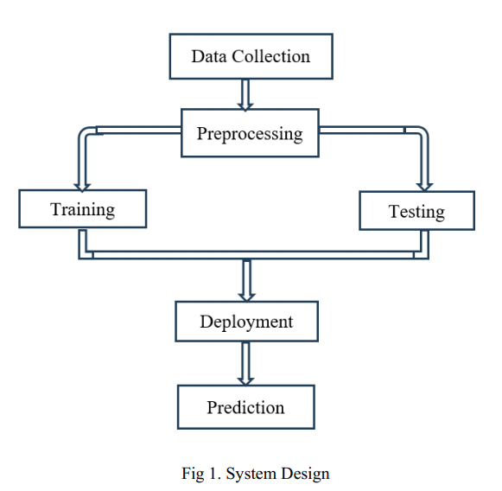
Proposed Work
NSL_KDD data is cleaned and preprocessed and the above important features are obtained by combining the feature selection techniques or strategies used are the recursive feature elimination,forward selection and backward elimination and correlation based feature selection.
After preprocessing of the data set the machine learning and deep learning models are trained and tested and their accuracies are obtained by test data set.
All the ML and DL models are then deployed into the website to make predictions about the attack type in the network.

Slide 10
DATASET
NSL_KDD DATA SET
Input Variables: 'dst_host_srv_serror_rate', 'service_ecr_i', 'flag_RSTO', 'service_urh_i', 'flag_OTH', 'dst_host_serror_rate', 'diff_srv_rate', 'dst_host_same_src_port_rate', 'serror_rate', 'flag_RSTOS0', 'wrong_fragment', 'protocol_type_icmp', 'logged_in', 'srv_serror_rate', 'dst_host_same_srv_rate', 'flag_RSTR', 'is_host_login', 'is_guest_login', 'srv_diff_host_rate', 'service_eco_i', 'flag_REJ', 'flag_S0', 'service_red_i', 'dst_host_srv_count', 'count', 'same_srv_rate', 'service_pop_3', 'protocol_type_udp', 'dst_host_srv_diff_host_rate', 'flag_SF', 'srv_count', 'dst_host_diff_srv_rate', 'flag_S3', 'num_failed_logins', 'land', 'flag_SH', 'flag_S2', 'flag_S1', 'service_urp_i', 'protocol_type_tcp', 'service_ftp'
Target Variables: 'apache2', 'back', 'buffer_overflow', 'ftp_write', 'guess_passwd','httptunnel', 'imap', 'ipsweep', 'land', 'loadmodule', 'mailbomb', 'mscan', 'multihop', 'named', 'neptune', 'nmap', 'normal', 'perl', 'phf', 'pod', 'portsweep', 'processtable', 'ps', 'rootkit', 'saint', 'satan', 'sendmail', 'smurf', 'snmpgetattack', 'snmpguess', 'spy', 'sqlattack', 'teardrop', 'udpstorm', 'warezclient', 'warezmaster', 'worm', 'xlock', 'xsnoop', 'xterm'

Slide 11
Network Intrusion Detection System website is developed front end is developed using css,html,javascript and the back end is developed using flask and python.
Users Data Base will be maintened by stroing the information of the user The website loads with the index page showing the Login and SignUp buttons and when the user signup and login then the home page will be opened where UPLOAD menu,NSL_KDD menu,ML_MODELS menu,DL_MODELS menus are present.
The machine learing models such as Decision Tree Classifier,LinearRegression,KNearestNeighbours,MultiNomial NavieBayes,RandomForest Classifier,Support Vector Machines,and deep learning models like Convulutional neural networks,recurrent neural networks,feed forward neural networks are developed and deployed into the system to classify the attacktype.
Our proposed system uses the Hard Voting Method and the final result is the atatck of a which had the highest probability of being predicted by each of the classifiers.
Among all the predicted attacks the attack which has the highest frequency is taken as the final result if no attack is common among the predicted attacks then the attack which is predicted by the algorithm which gives the higher accuracy is taken as the final result.the data set by which the models have been trained and tested is NSL-KDD data set.

Slide 12
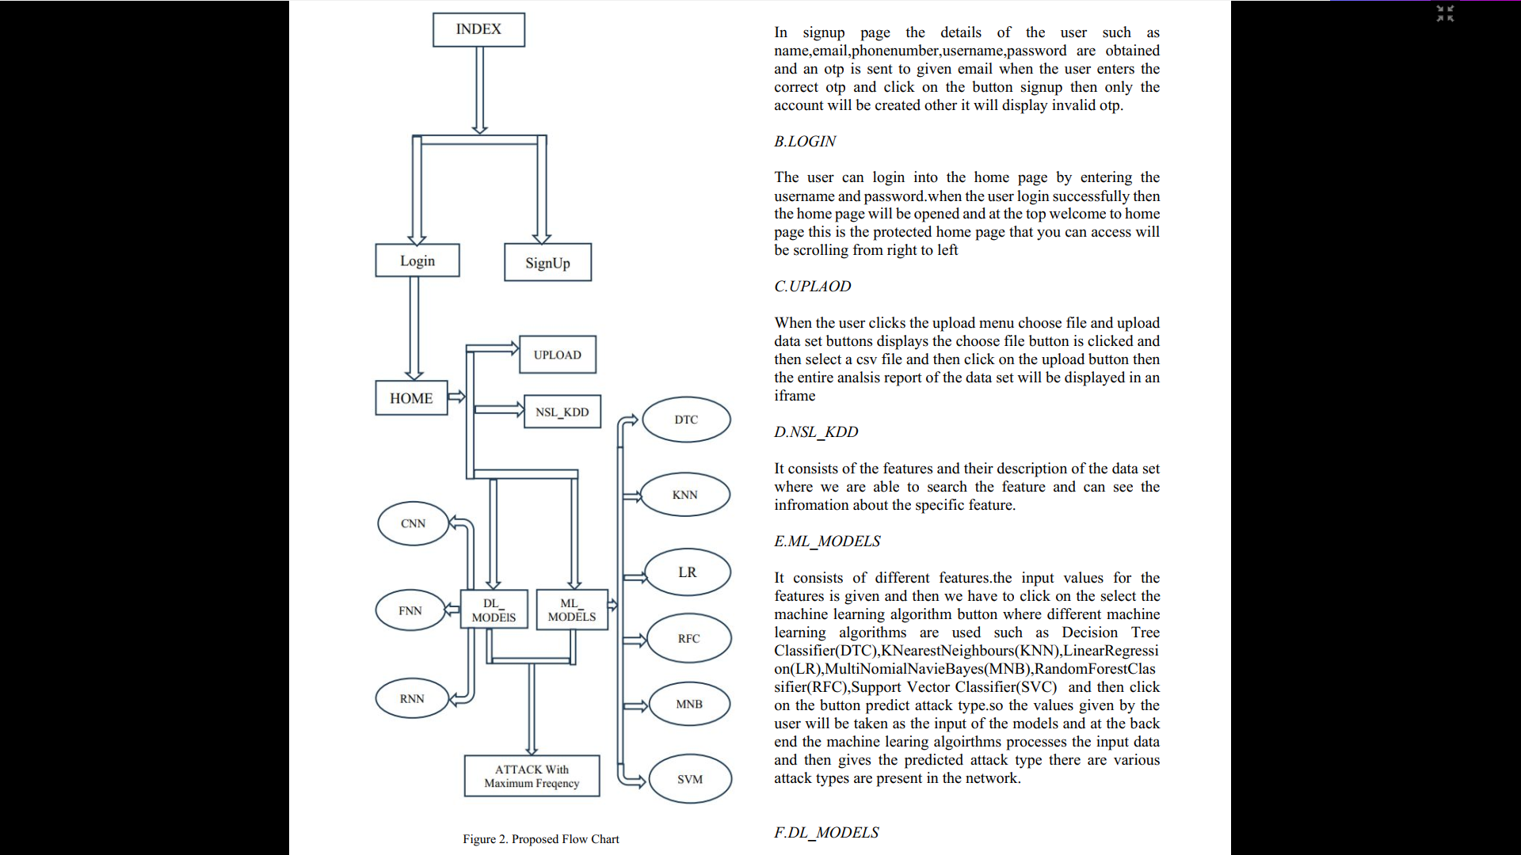

Slide 13
Modules Used:
A.SIGNUP
In signup page the details of the user such as name,email,phonenumber,username,password are obtained and an otp is sent to given email when the user enters the correct otp and click on the button signup then only the account will be created other it will display invalid otp.
B.LOGIN
The user can login into the home page by entering the username and password.when the user login successfully then the home page will be opened and at the top welcome to home page this is the protected home page that you can access will be scrolling from right to left

Slide 14
C.UPLAOD
When the user clicks the upload menu choose file and upload data set buttons displays the choose file button is clicked and then select a csv file and then click on the upload button then the entire analsis report of the data set will be displayed in an iframe
D.NSL_KDD
It consists of the features and their description of the data set where we are able to search the feature and can see the information about the specific feature.

Slide 15
E.ML_MODELS
It consists of different features.the input values for the features is given and then we have to click on the select the machine learning algorithm button where different machine learning algorithms are used DecisionTreeClassifier(DTC),KNearestNeighbours(KNN),LinearRegression(LR),MultiNomialNavieBayes(MNB),RandomForestClassifier(RFC),Support Vector Classifier(SVC) and then click on the button predict attack type.so the values given by the user will be taken as the input of the models and at the back end the machine learing algoirthms processes the input data and then gives the predicted attack type there are various attack types are present in the network.

Slide 16
F.DL_MODELS
It consists of different features. The input values for the features is given and then we have to click on the select the deep learning algorithm button where different deep learning algorithms or models have been used are convolutional neural networks(CNN),recurrent neural networks(RNN) and Feed forward neural networks(FNN) and then click on the button predict attack type.so the values given by the user will be taken as the input of the models and at the back end the deep learning algorithms processes the input data and then gives the predicted attack type.

Slide 17
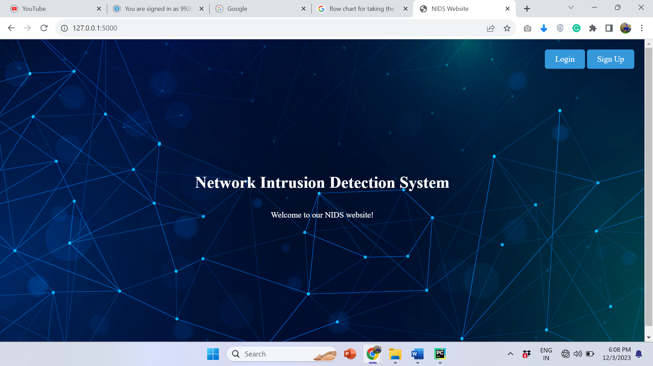
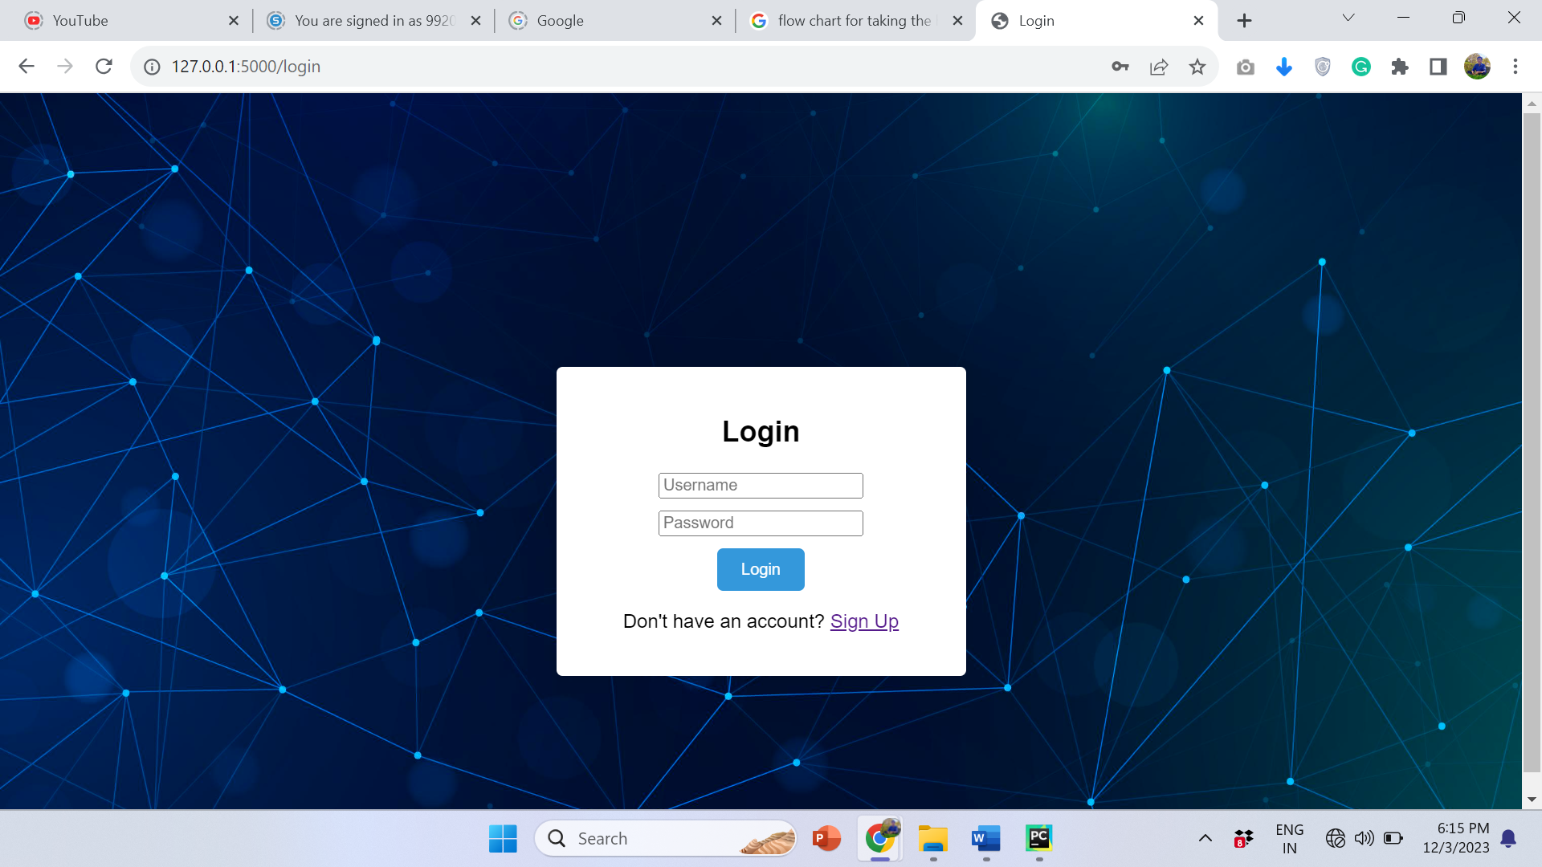
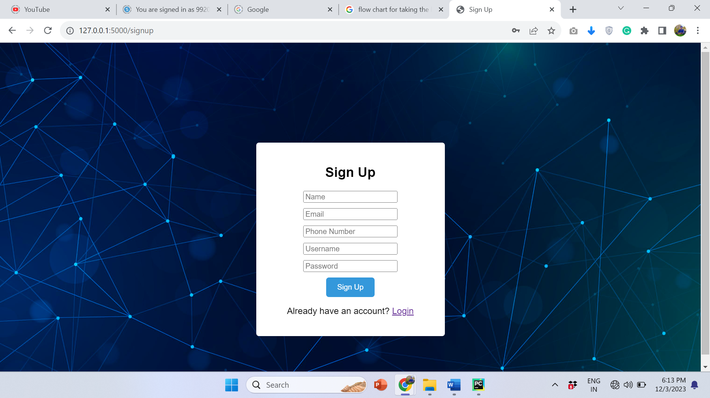


Slide 18
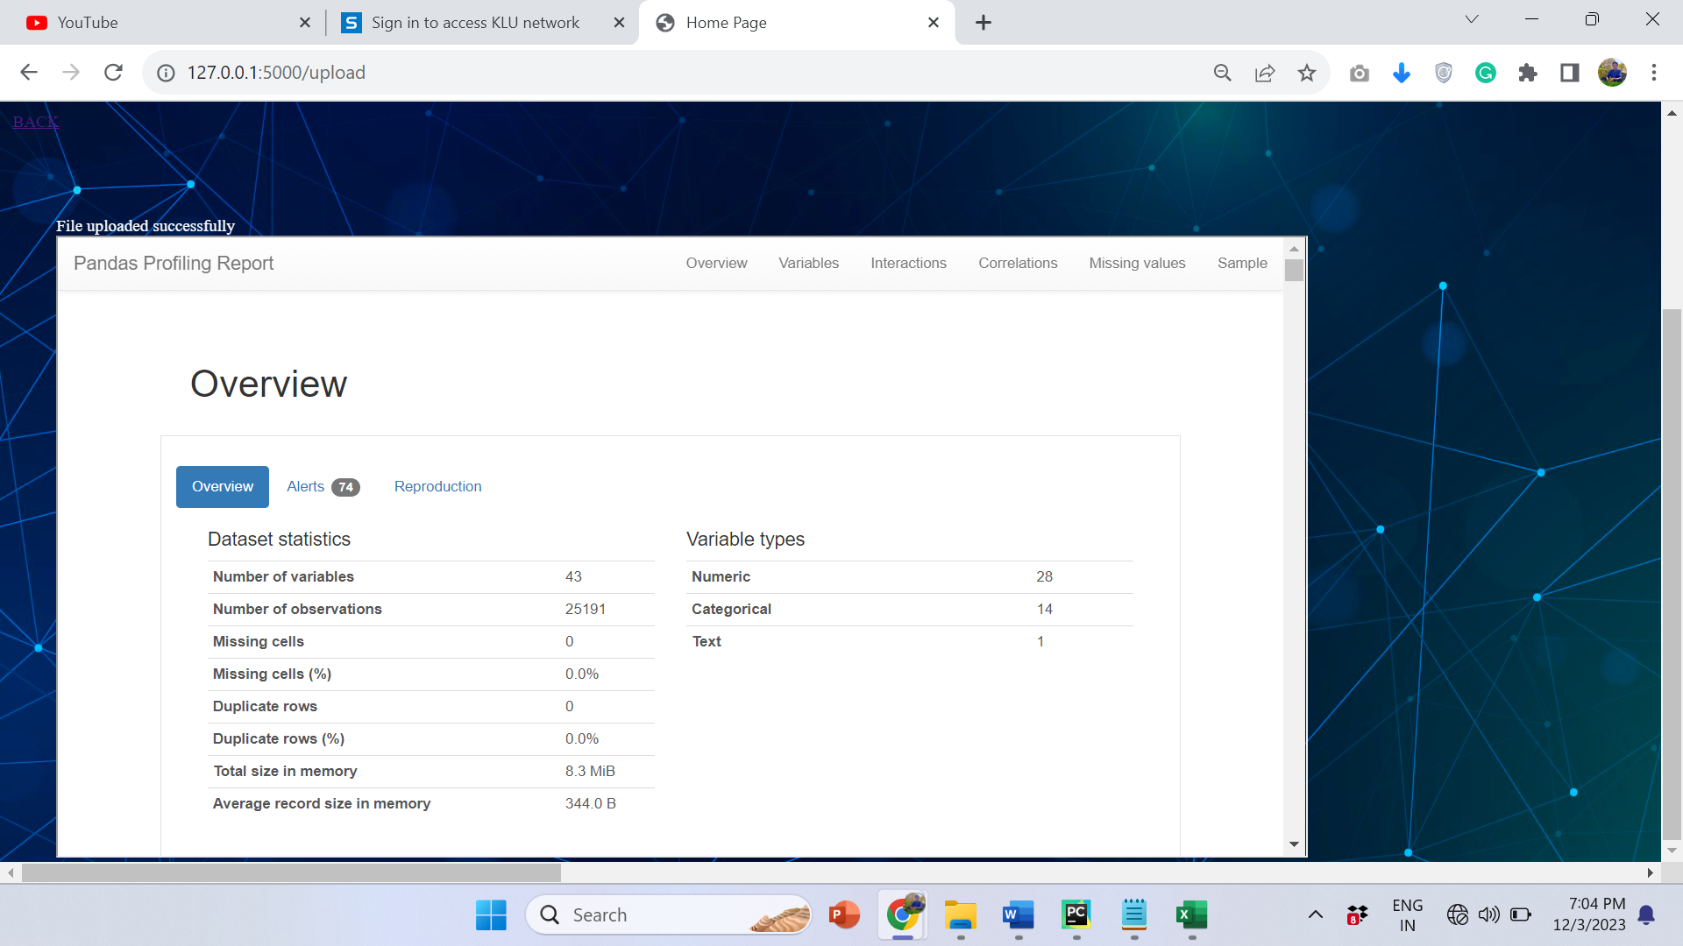
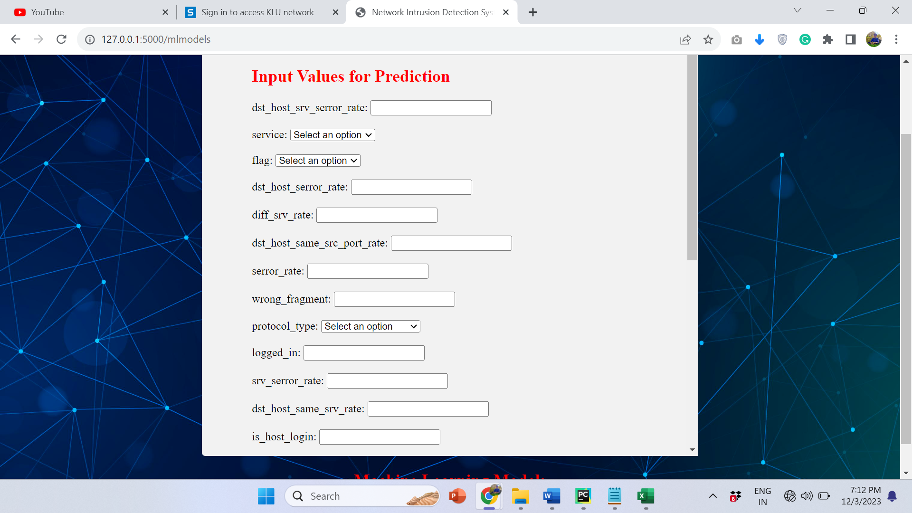
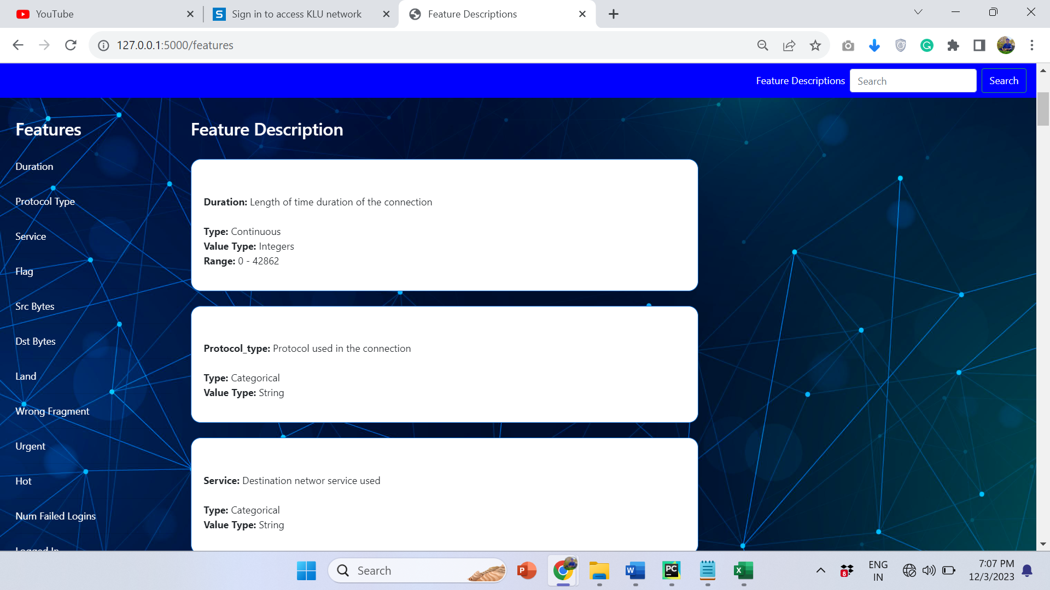
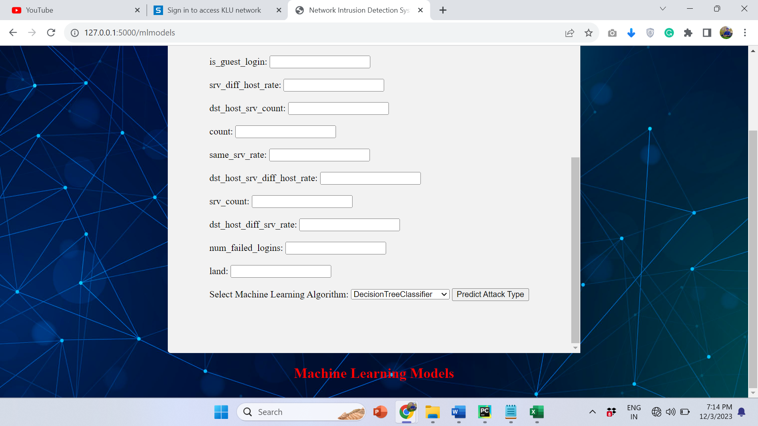

Slide 19
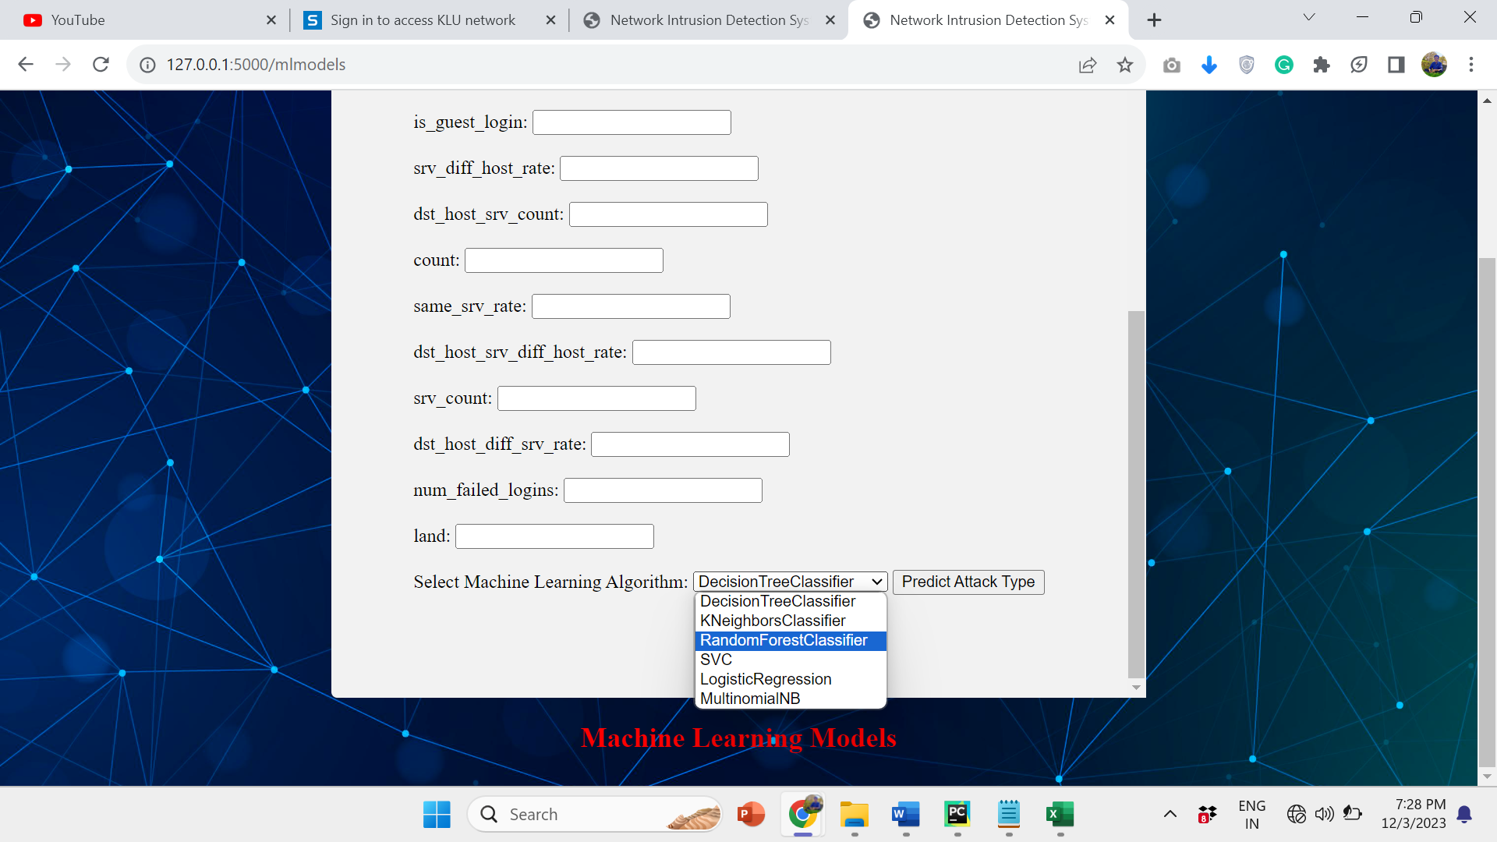
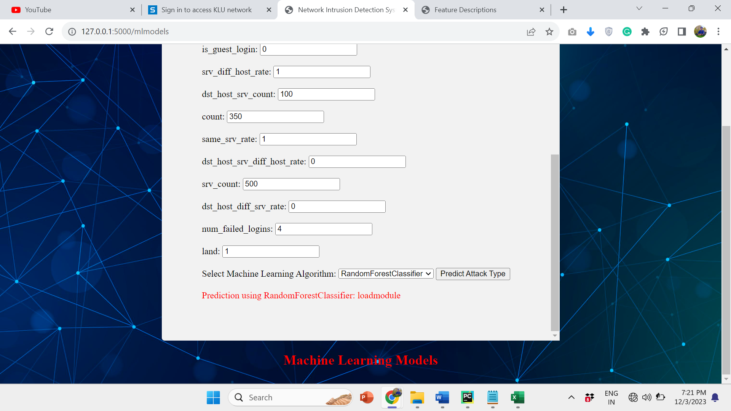
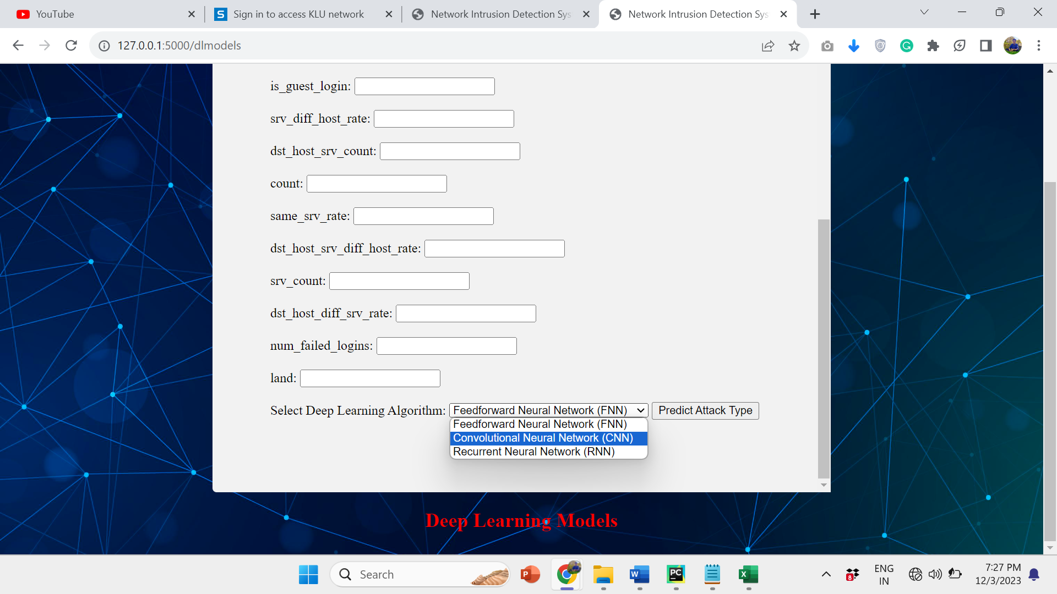
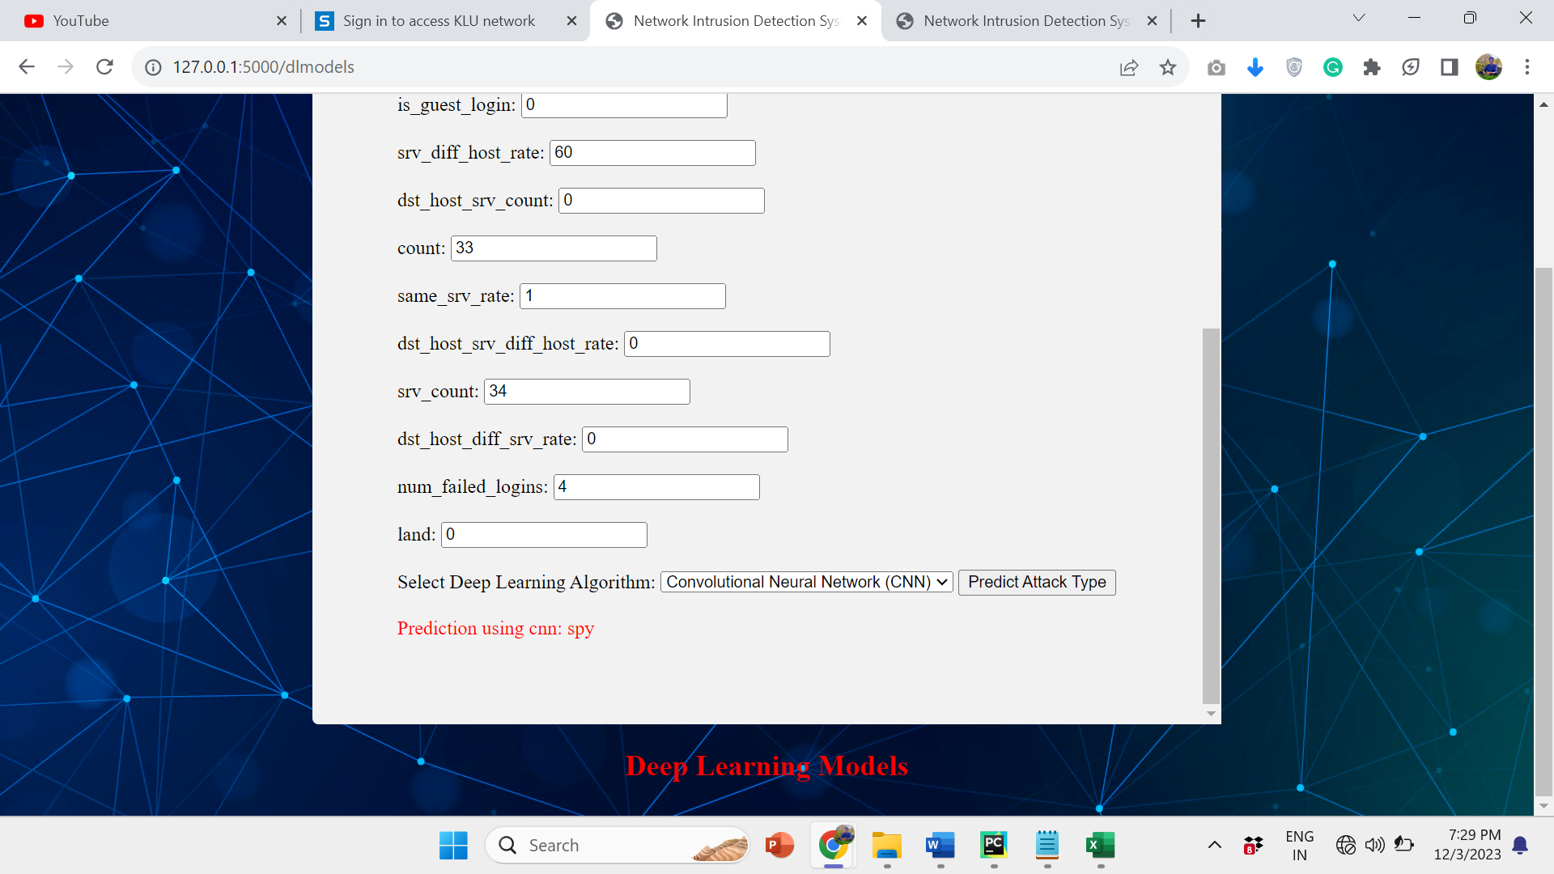

Slide 20
Conclusion
Network intrusion detection system using the machine learning and deep learning algorithms offers promising solutions to bolster cybersecurity measures. Through the utilization of various algorithms, like decision trees, random forests, support vector machines, and neural networks, this project aims to enhance the accuracy and efficiency of detecting anomalous activities within networks.By leveraging machine learning models, the system can learn patterns from network data and distinguish between normal and malicious behavior, thereby fortifying preemptive measures against potential cyber threats. Deep learning algorithms, particularly neural networks, exhibit the capacity to analyze intricate network data, uncover hidden patterns, and adapt to evolving threats in real-time.This project's potential lies in its ability to continuously improve its detection capabilities through iterative learning, enabling the system to stay updated and resilient against emerging intrusion techniques. Furthermore, the integration of machine learning and deep learning techniques allows for a more comprehensive and sophisticated approach to identifying various types of network intrusions, including intrusion attempts, malware attacks, and unauthorized access.In conclusion, the integration of the machine learning algorithms and the deep learning algorithms in a network intrusion detection system presents a powerful framework to proactively safeguard networks against cyber threats

